Slide 1
Corrosion monitoring – Quantification of corrosion loss to control corrosion
Dr G H Thanki
Director & Principal Consultant
Corrosion Control & Monitoring Consultancy
Vadodara
www.corrosionawreness.com
Lecture delivered as course leader
During Two day Programme on
“Advanced Corrosion Management 2014”
Mumbai on 30th & 31st Jan 2014
Organized by
Indian Knowledge Center

Slide 2
Corrosion Monitoring
Plant operation efficiency requires the relative costs of initial investment and maintenance are balanced against the increased environmental needs and the costs of reliability, plant stream days and down time.

Slide 3
Corrosion Monitoring
Important factors in the design and operation of a plant are constrains arising from the materials of construction with regard to corrosion, degradation and temperature limitations in the process environments.

Slide 4
Corrosion Monitoring
Corrosion is a difficult phenomenon to control in an economical manner.
Unlike the measurement of some process control parameters such as pressure, flow, pH or temperature, it has not been possible to measure various manifestation of corrosion activity in real time
until recently

Slide 5
Corrosion Monitoring
Corrosion control strategies traditionally & typically adapt the approaches like selection of materials of construction and coatings, the use of inhibitors and chemical treatments, electrochemical protection like cathodic/anodic techniques and modifications of operational parameters including throughput

Slide 6
Corrosion Monitoring
Reliability, longer plant stream days, operations of plant equipment to its close design tolerance are emphasized in
these days of
high competence and competitive world,
so
materials selection and other corrosion control measures tend to be conservative.

Slide 7
Corrosion Monitoring
In many cases, corrosion experts solve problems by determining the cause of damage using post-mortem investigations and by recommending methods of avoiding the problem in the future,
rather than by
a more forward looking preventive approach.

Slide 8
Corrosion Monitoring
Corrosion Monitoring Mantra:
Measure (Monitor),
Understand,
Control,
Improve...

Slide 9
Corrosion Monitoring
Perhaps, when solemnly visiting a giant manufacturing corporation or two,
you too have observed a
quality assurance "mantra"
on a notice board or two that states something like:
"If you can't measure something, you can't understand it ... if you can't understand it, you can't control it ... if you can't control it, you can't improve it."

Slide 10
Corrosion Monitoring
Replace "something" and "it" with "corrosion" (and allow yourself a bit of artistic word freedom) to obtain the following basic corrosion measurement and monitoring mantra:
"If you do not measure (monitor*) corrosion, you can't understand it ... if you can't understand corrosion, you can't control it or improve your corrosion control methods."
*recognizing that corrosion monitoring is basically an organized,
systematic form of corrosion measurements.

Slide 11
What Is Corrosion Monitoring?
Corrosion monitoring can be described as
"The regular measurement of corrosion or corrosivity as it effects an ASSET"
It is most often used
to make comparisons between actual and predicted corrosion rates
or
for the evaluation of measures taken in prevention or mitigation

Slide 12
What Is Corrosion Monitoring?
It is most often used to make comparisons between actual and predicted corrosion rates
or
for the evaluation of measures taken in prevention or mitigation

Slide 13
What Is Corrosion Monitoring?
The asset may equally be a pipeline, a concrete bridge, a large HVAC system in a building, offshore oil & gas facility or a printed circuit in a computer
When that part of the asset that is of interest is inaccessible
Simple methods such as visual inspection or manual measurement can not be used and special techniques must be introduced

Slide 14
What Is Corrosion Monitoring?
The special techniques introduction is especially true for continuous processes, where internal corrosion may advance at a rapid rate and lead to catastrophic failure long before traditional "inspection" can detect it.
Corrosion Monitoring has therefore, come to be associated mainly with internal corrosion of process equipment

Slide 15
Why monitor?
Corrosion is not an isolated phenomenon
It is a natural process that attacks any material, particularly metals, under the right conditions
However carefully a process plant is designed and the materials of construction selected - the risk of corrosion is only reduced
Experience tells us, often with horrific consequences, that it is never eliminated

Slide 16
Why monitor?
Failures due to corrosion can be costly to repair
Costly in terms of lost or contaminated product
Costly in terms of pollution and environmental damage
(This in turn may result in fines or closure of the installation)
and
Ultimately it may be costly in terms of human safety

Slide 17
Why monitor?
Fear of corrosion can result in over-design or selection of materials - which are not otherwise ideal
Addition to capital cost make Projects commercially unattractive or unfeasible
So that
Ultra-safe design alone is not a correct response

Slide 18
Why monitor?
Corrosion monitoring can be used as a pro-active tool to assist with operating the plant in a more effective way
Thereby
Prolonging life and gaining optimum throughput
Most operators seek to solve corrosion problems by using some form of chemical treatment (say: cooling water treatment) in conjunction with careful materials selection

Slide 19
Why monitor?
In each case a fine balance must be found between
The cost of treatment
The rate of plant deterioration and
The rate of production
to meet
Business objective

Slide 20
Why monitor?
Corrosion Monitoring is a key tool to Advice
-When to treat and what the corrosion rate will be in any given mode of operation
This is information that can drive a continuous improvement process

Slide 21
Corrosion Monitoring Techniques
The range of available monitoring techniques is wide, but for the simplicity it can be broadly be categorized as
Direct and Indirect

Slide 22
Corrosion Monitoring Techniques
Direct techniques
Corrosion Coupons (intrusive)
Electrical Resistance (ER) (intrusive)
Inductive Resistance Probes (intrusive)
Linear Polarization Resistance (LPR) (intrusive)
Electrochemical Impedance Spectroscopy (EIS) (intrusive)
Electrochemical frequency modulation (intrusive)

Slide 23
Corrosion Monitoring Techniques
Direct techniques
Harmonic Analysis (intrusive)
Electrochemical Noise (EN) (intrusive)
Zero Resistance Ammetry (ZRA) (intrusive)
Potentiodynamic Polarization (intrusive)
Thin Layer Activation (TLA) and Gamma Radiography (intrusive or non-intrusive)
Electrical Field Signature Method (EFSM) (non-intrusive)
Acoustic Emission (AE) (non-intrusive)

Slide 24
Corrosion Monitoring Techniques
Indirect techniques
Corrosion Potential (non-intrusive)
Hydrogen Flux Monitoring (non-intrusive)
Chemical Analyses

Slide 25
Corrosion Monitoring Techniques
Corrosion Coupons (intrusive)
The weight loss technique is the best known and simplest of all corrosion monitoring techniques
The method involves exposing a specimen of
Material (coupon) to a process environment
For a given duration
Then removing the specimen for analysis

Slide 26


Corrosion Monitoring Techniques
Corrosion Coupons (intrusive)
WEIGHT LOSS COUPONS
FIXED COUPON HOLDER

Slide 27
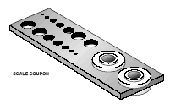

Corrosion Monitoring Techniques
SCALE COUPON
DISC COUPON

Slide 28
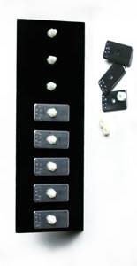
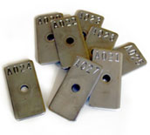
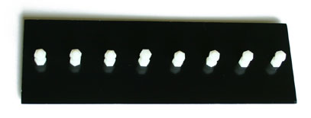
Weight Loss Coupons…
Coupons
01x02x0.125 inch Steel Coupons
Alpha Numeric I.D. Stamped
Center Hole - 1/4" in Diameter
Weight (mass) loss coupons, also known as corrosion coupons are used as a validation tool in the cyclic corrosion test process.
Coupon Racks
Holds 8 Coupons
Non-Metallic Construction
Includes Nylon Fasteners
Fits Standard Panel Holder

Slide 29
Corrosion Monitoring Techniques
Corrosion Coupons (intrusive)
Corrosion coupon
Offers simplified measurement
hence
Forms the baseline method of measurement
In many corrosion monitoring programs

Slide 30
Corrosion Monitoring Techniques
Corrosion Coupons (intrusive)
A sample of the material of interest,
Known weight,
Exposed to the process for a period,
Removed,
Carefully cleaned and
Weighed.
The change in weight is used to calculate the metal loss to be expressed as an annualized rate of loss (mils or millimeters per year)

Slide 31
Corrosion Monitoring Techniques
Corrosion Coupons (intrusive)
The coupon requires a long exposure to yield accurate results. Thirty days is usually considered a minimum exposure time
Time constrain of exposure limits the number of data points and do not detect process changes quickly.

Slide 32
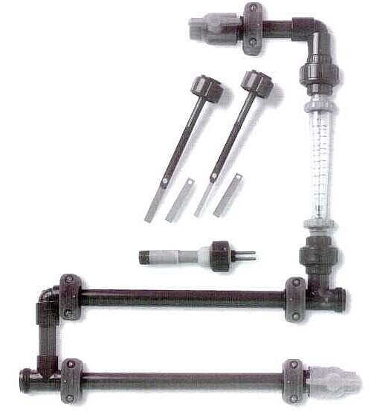
Corrosion Coupons (intrusive)
Flow Water Gauge
Coupons
Intrusive Probe

Slide 33
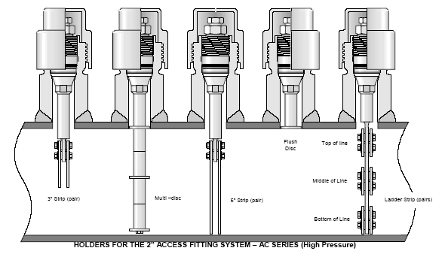
Corrosion Monitoring Techniques
Corrosion Coupons (intrusive)

Slide 34
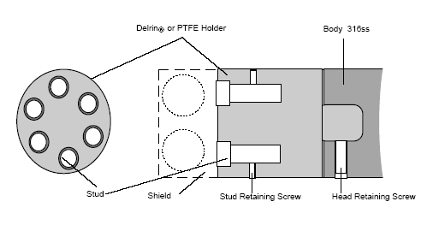
Corrosion Monitoring Techniques
Corrosion Coupons (intrusive)
Biofilm Monitoring Probe

Slide 35
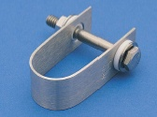
Corrosion Monitoring Techniques
Corrosion Coupons (intrusive)
Based on geometric designs, a wide variety of corrosion phenomena
may be studied which includes
Compressive Stress
Stress-assisted Corrosion
Tensile Stress
Bimetallic (galvanic) attack
Differential Aeration

Slide 36
Corrosion Monitoring Techniques
Corrosion Coupons (intrusive)
ADVANTAGES
The technique is applicable to all environments – gases, liquids,
solids/particulate flow
Visual inspection can be undertaken
Corrosion deposits can be observed and analyzed
Weight loss can be readily determined and
Corrosion rate easily calculated
Localized corrosion can be identified and measured
Inhibitor performance can be easily assessed

Slide 37
Corrosion Monitoring Techniques
Corrosion Coupons (intrusive)
Most useful in environments
Where corrosion rates do not significantly change
Over a long time periods
They can provide a useful correlation with other
Techniques such as ER and LPR measurements

Slide 38
Corrosion Monitoring Techniques
Corrosion Coupons (intrusive)
‘Good Practices’ In The Application For Coupon Testing
The chemistry and processing history of the Material in the
coupon must be known
The coupon must be positively identified Usually by code
numbers stencilled into the Specimen
Data about the specific coupon test should be
Recorded in a permanent logbook

Slide 39
Corrosion Monitoring Techniques
Corrosion Coupons (intrusive)
Items which must be recorded like:
Detailed information on the coupon
(chemistry, mechanical properties and processing history)
Dimension of the coupon
Initial weight of the coupon
Initial surface condition
Location
Condition of Exposure
Time of exposure must also be recorded

Slide 40

Corrosion Monitoring Techniques
Corrosion Coupons (intrusive)
COUPON AFTER EXPOSURE TO A CORROSIVE MEDIUM
Evaluation of general mass-loss corrosion rate
(In millimetres per year - mmpy) from coupon tests Equation
Corrosion Rate (in mmpy) = (8.76 × 104) M/ADT
Where,
M=mass loss g;
A=surface area, cm2;
D=density, g/cm3; and
T=time, h.
mmpy x 40 = (mpy)

Slide 41
Corrosion Monitoring Techniques
Corrosion Coupons (intrusive)
Useful parameters for localized corrosion
are
The Ratio The maximum localized attack rate
The general corrosion
As determined by
Mass loss and the percent of the corrosion-affected area on the coupon

Slide 42
Electrical Resistance (ER) (intrusive)
Corrosion Monitoring Techniques
ER probes can be thought of as
"smart- electronic”
corrosion coupons
Like coupons, ER probes provide a basic measurement
of metal loss
Unlike coupons, the value of metal loss can be
Measured at any time
While the probe is in-situ and permanently exposed
to the process stream

Slide 43
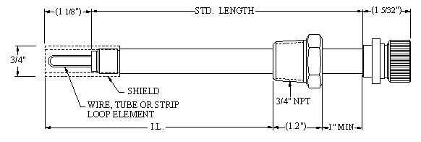
ELECTRICAL RESISTANCE MONITORING
ELECTRICAL RESISTANCE PROBE (ER)
The ER technique measures the change in Ohmic resistance of a
corroding metal element exposed to the process stream
The action of corrosion on the surface of the element produces a
decrease in its cross-sectional area with a corresponding increase in its
electrical resistance
The increase in resistance can be related directly to metal loss and the
metal loss as a function of time is by definition the corrosion rate

Slide 44
ELECTRICAL RESISTANCE MONITORING
These Ratio-metric probes are constructed with an exposed Sample and a protected Reference element.
The two elements are nominally at the same temperature and any temperature induced change in resistivity is compensated for by comparing the resistance measured in both elements.

Slide 45
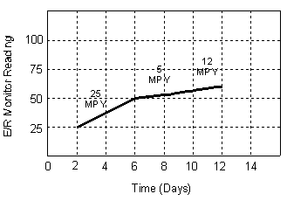
ELECTRICAL RESISTANCE MONITORING
If the two resistances are expressed as a ratio, any change in the result can be attributed to loss of material from the sample.
by taking the results of a series of measurements at timed intervals, a rate of loss can be calculated
The response time for ER monitoring is far shorter than weight loss coupons
A typical response times

Slide 46
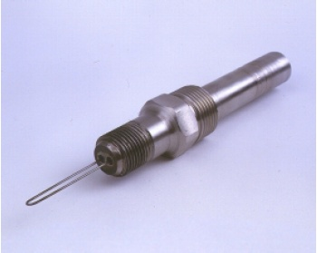
Electrical Resistance Probe

Slide 47
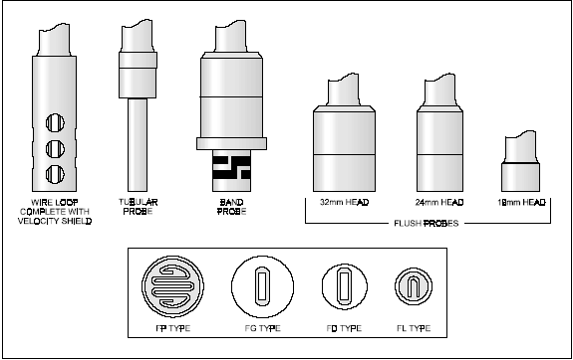
ER Probes Element Configuration

Slide 48
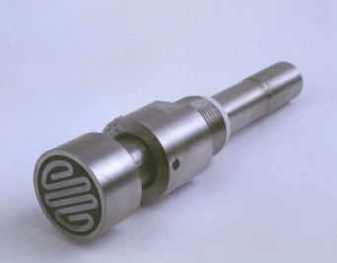
Adjustable Flush ER Probe

Slide 49
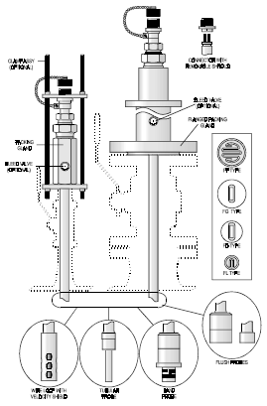
ELECTRICAL RESISTANCE MONITORING
ER probes are available in a variety of element geometries, metallurgies
and sensitivities, can be configured for flush mounting such that pigging
operations can take place without the necessity to remove probes.
Electrical Resistance Probes: Flush, Tubular, Wire Loop, Tube Loop, Band

Slide 50
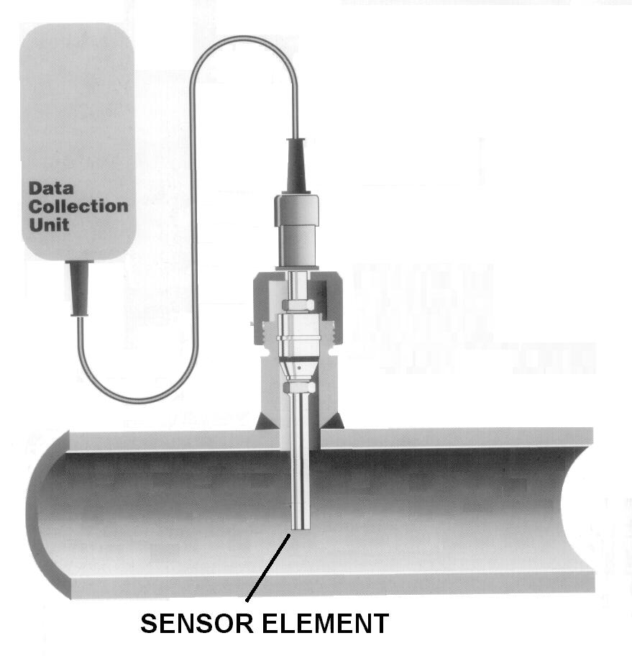
On-line corrosion monitoring of a process fluid

Slide 51
ELECTRICAL RESISTANCE MONITORING
ER probes have all the advantages of coupons
+
They are applicable to all working environments gases, liquids,
solids, particulate flows
Direct corrosion rates can be obtained
Probe remains installed in-line until operational life has been
exhausted
They respond quickly to corrosion upsets and can be used to
trigger an alarm

Slide 52
ELECTRICAL RESISTANCE MONITORING
ER, HOWEVER, DOES HAVE ITS LIMITATIONS
It only provides representative data for General corrosion
and usually cannot Accurately detect localized attack
The probes, although available in varying sensitivities
typically require several days to determine a reliable
corrosion corrosion- Rate trend
Therefore, if the process is prone to rapid changes in corrosivity,
ER probes will not provide accurate and reliable data.

Slide 53
ELECTRICAL RESISTANCE MONITORING
In some cases
Like
When H2S is present, ER devices will show an error due to
The presence of conductive corrosion products on their
Sensing elements. This leads to nonconservative results.
So
The data from ER probes should be compared to that from
Coupons taken-during the same time.

Slide 54
ELECTRICAL RESISTANCE MONITORING
The sensing element itself can be manufactured in one of many geometries like:
Wire loop, Tube loop, Strip loop, Cylindrical, Spiral loop etc.
Flush Mount Elements
are designed to be mounted flush with the vessel wall. This element is very effective at simulating the true corrosion condition along the interior surfaces of the vessel wall. Being flush, this element is not prone to damage in high velocity systems and can be used in pipeline systems that are subject to pigging operations.

Slide 55
ELECTRICAL RESISTANCE MONITORING
Surface strip elements
are thin rectangular elements with a comparatively large surface area to allow more representative results in non-homogeneous corrosive environments. Strip elements are commonly used in underground probes to monitor the effectiveness of
cathodic protection
currents applied to the external surfaces of buried structures

Slide 56
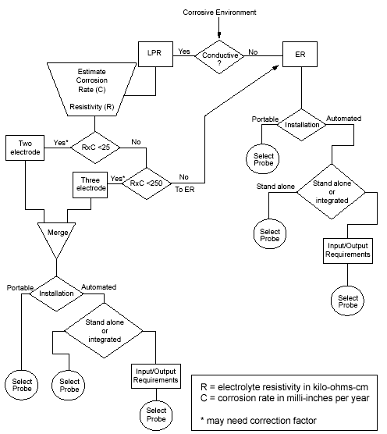
Algorithm for suitability of ER and LPR corrosion monitoring techniques

Slide 57
RATIO METRIC METAL LOSS MEASUREMENT - CEION® TECHNOLOGY
CEION® IS A NEW RATIO METRIC METAL LOSS
MEASUREMENT TECHNOLOGY
WITH
RESOLUTION THAT IS AT LEAST 100 TIMES BETTER
THAN EXISTING ER BASED DEVICES

Slide 58
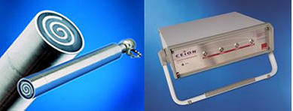
CEION® - a ratiometric metal loss measurement technology
Resolution is at least 100 times better than existing ER based devices. It is ideal for monitoring oil/gas production and processing systems. A technology that is just as capable of driving the real-time control loop of an inhibitor pump as it is of operating without maintenance between planned shutdowns

Slide 59
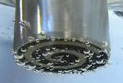
CEION® nanometer metal loss and electrochemical technology
CEION® is the state-of-the-art technology to detect material loss and electrochemical conditions at the metal-solution interface. Exceptional instrumentation yields performance in the sub-nanometre (<10-9m) domain with resolutions equivalent to the atomic radii of iron (125 picometre).

Slide 60
RATIO METRIC METAL LOSS MEASUREMENT - CEION® TECHNOLOGY
CEION® is also first choice technology for sub-sea and sub-
surface applications
Where access and reliability are key factors
But
Fast response is still essential.

Slide 61
RATIO METRIC METAL LOSS MEASUREMENT - CEION® TECHNOLOGY
Earlier ratio metric devices known
as electrical resistance (ER) probes Have Limited Speed Of Response
but
New CEION® Technology has greatly Improved
every aspect of Ratio Metric Measurement
Using patented features that extend life and
sensitivity
and
Eliminate Temperature Induced Effects

Slide 62
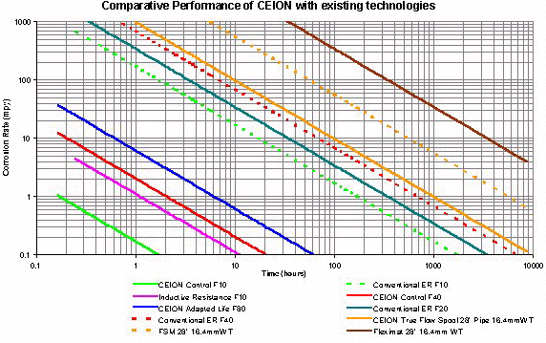
RATIO METRIC METAL LOSS MEASUREMENT - CEION® TECHNOLOGY

Slide 63
ELECTROCHEMICAL TECHNIQUES
Linear Polarization Resistance (LPR) (intrusive)
This is the most widely used technique of this type. It measures the DC current through the metal/fluid interface when the electrodes are polarized by a small electrical potential.
As this current is related to the corrosion current that in turn is directly proportional to corrosion rate, the method provides an instantaneous measurement of corrosion rate.

Slide 64
ELECTROCHEMICAL TECHNIQUES
Linear Polarization Resistance (LPR) (intrusive)
This has advantages over metal loss methods, but is
limited in the scope of its application by the requirement that the fluid is conductive, which in
practice limits it to aqueous solutions.
Electrochemical Monitoring Probes use two or three electrodes of the material of interest, which are usually either finger (projecting) type or flush.
As the measurement is attempting to replicate what is occurring at the metal/fluid interface in the system, it is logical to use flush types in field applications, wherever possible.

Slide 65
ELECTROCHEMICAL TECHNIQUES
Linear Polarization Resistance (LPR) (intrusive)
Polarization resistance is particularly useful as a method to rapidly identify corrosion upsets and initiate remedial action, thereby prolonging plant life and minimizing unscheduled downtime.
The technique is utilized to maximum effect, when installed as a continuous monitoring system. This technique has been used successfully for over thirty years, in almost all types of water-based, corrosive environments.

Slide 66
ELECTROCHEMICAL TECHNIQUES
Linear Polarization Resistance (LPR) (intrusive)
Some of the more common applications are
Cooling water systems
Secondary recovery system
Potable water treatment and distribution systems
Amine sweetening
Waste water treatment systems
Pickling and mineral extraction processes
Pulp and paper manufacturing
Hydrocarbon production with free water

Slide 67
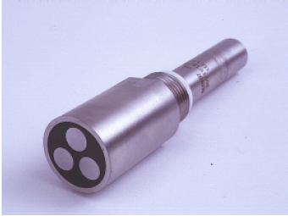
ELECTROCHEMICAL TECHNIQUES
A flush 3- electrode LPR Probe

Slide 68
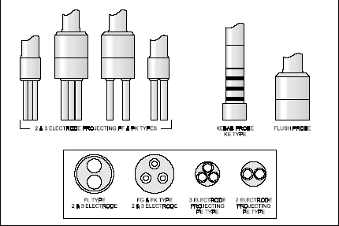
ELECTROCHEMICAL TECHNIQUES
Specialized Probes for LPR Monitoring in either
Flush or Projecting Electrode Form

Slide 69
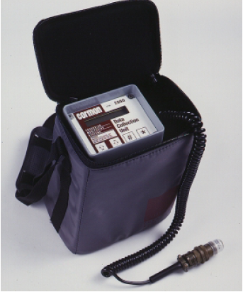
ELECTROCHEMICAL TECHNIQUES
Portable Data Collection Unit

Slide 70
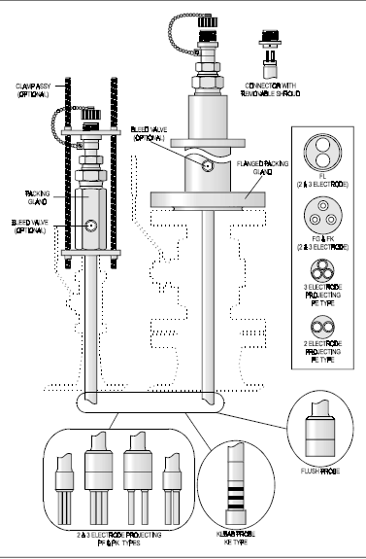
Retractable Linear Polarization Resistance Probes – Flush and Projecting Type
(Up to-Pressure: 1500 psi & Temperature: 260°C)

Slide 71
The Equipment Selection Process
The selection process must incorporate the questions:
What information will help me to realise an identifiable and quantifiable improvement?
How can I obtain this information?
Can I justify the cost of obtaining it?

Slide 72
ACCESS
One key factor in any monitoring system is the access to the process that is available for inserting sensors.
In the majority of cases there will be limitations placed on the ideal by the layout of the plant, this is particularly true of sites, where bottom of line access would be preferred but space is not available.

Slide 73
ACCESS
The following information is needed to select an access system:
Are sensors to be changed on or off line?
Maximum operating pressure
Max/min. operating temperature
Material and wall thickness of pipe or vessel
Insertion required ( flush, middle of line etc.)
Orientation (usually expressed as ‘o’clock’, twelve being top of line)
Clearance available
Client preference / existing system

Slide 74
THE OPTIONS CAN BE SUMMARIZED IN TABLE FORM AS FOLLOWS:
METHOD | MANUAL | LOGGING | REAL-TIME
CHARACTER | BASELINE | BASELINE /PROACTIVE | PRO-ACTIVE
CAPITAL COST | LOWEST | MEDIUM | HIGH
OPERATION COST | HIGH | MEDIUM | LOW
DATA ITEM COST | HIGH | LOW | LOWEST
RELIABILITY | LOWEST | GOOD | VERY GOOD

Slide 75
Electrochemical Noise
Electrochemical noise refers to
‘naturally occurring fluctuations in corrosion potential and corrosion current flow’
It does not refer to an acoustic measurement.
Electrochemical noise monitoring can be further subdivided into
electrochemical potential noise (EPN) measurements and
electrochemical current noise (ECN) measurements.
The combined monitoring of potential and current is particularly useful.

Slide 76
Electrochemical Noise
ECN is a passive electrochemical technique that
Requires no polarizing current
It measures the naturally occurring electrochemical potential and current disturbances, that are due to corrosion activity
It is capable of giving accurate indications of General Corrosion, Pitting and Stress Cracking
Requires both expertise and computer power to be effective

Slide 77
Electrochemical Noise
Electrochemical noise data can provide an indication of the type of corrosion damage that is occurring
It is widely used to distinguish between general and localized attack.
The severity of localized can also be gauged by the number and shape of the noise transients.
This is an important advantage over other electrochemical techniques.
Further fundamental advantages include the ability to monitor corrosion in low conductivity environments
( Thin Film Condensation)
and
the absence of "artificial" polarization effects. Noise measurements are made in the completely "natural" (freely corroding) state.

Slide 78
What Is Corrosion Monitoring?
Corrosion monitoring can be described as
"The regular measurement of corrosion or corrosivity as it effects an ASSET"
It is most often used
to make comparisons between actual and predicted corrosion rates
or
for the evaluation of measures taken in prevention or mitigation

Slide 79
Electrochemical Noise
The combination of ECN with ER probes has proved a powerful tool for on-line real-time monitoring of :
        General (uniform) corrosion,
        Erosion and
        Localized attack such as pitting

Slide 80
Electrical Field Signature Method (EFSM) (non-intrusive)

Slide 81
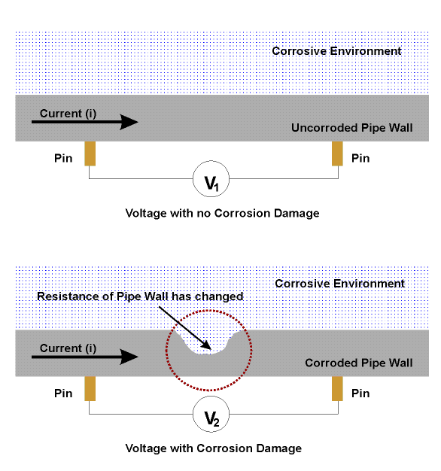
Field Signature Method
The FSM™ technique is non-intrusive and is used to measure corrosion damage over a relatively large section of a structure.
Sensing pins, strategically positioned over the area of interest, are used to measure the voltage response to an induced current.
This type of measurement between two pins is closely related to an electrical resistance measurement.

Slide 82
Field Signature Method
The sensing pins are typically separated by a distance of
2-3 times wall thickness.
It is the change in the measured voltage distribution (the electrical field "pattern") that is related to a change in wall thickness of the instrumented structure.
Essentially successive measurements are used for comparative purposes, to detect a change in the degree of corrosion damage.

Slide 83
Introduction To FSM Technology
It can be installed on process piping, elbows, reducers, buried pipelines, pressure vessels and storage tanks.
Depending on pipe geometry and the desired monitoring area, a matrix normally consists of 28, 56 or 84 sensing pins (electrodes).
The pins are stud welded to the outer wall of the pipe along with current feeding cables, temperature sensors and a reference plate.
This hardware is all connected via a Sensing Matrix Interface (SMI) and a series of cables connected to a junction mounted at a convenient location.

Slide 84
Introduction To FSM Technology
When a new measurement on the FSM matrix is required, a portable instrument is manually hooked to the junction box
The instrument feeds a current through the matrix, and then records the voltage levels between each measuring pin pair
The reading is stored in the instrument and subsequently downloaded to a laptop for analysis using FSM trend software, where measurements are compared with the original signature to produce an accumulated metal loss value.

Slide 85
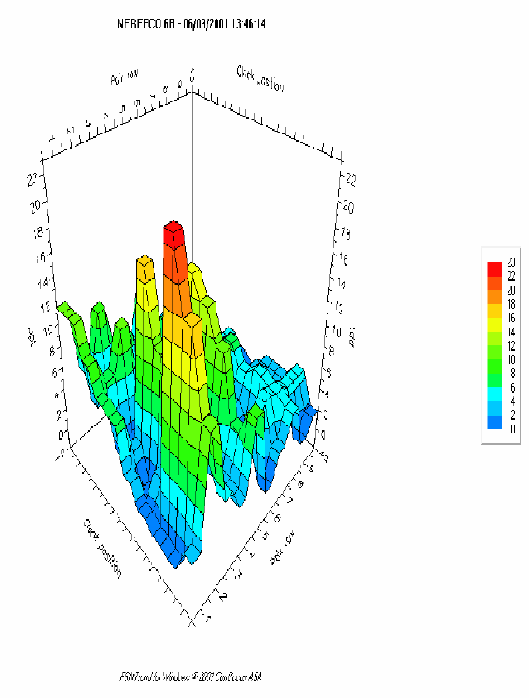
The software processes the data along with temperature changes to produce plots of metal loss (corrosion), as well as 3D plots to illustrate the accumulated metal loss over the whole matrix.
The FSM measurements are based on comparison with a reference in order to compensate for temperature variations.
These readings are taken in parallel with the pin matrix readings and are taken on a reference plate, which is thermally coupled, to the monitored object. The reference plate is fabricated of the same material as the pipe to be monitored and is machined to fit the curvature of the actual pipe.

Slide 86
Field Signature Method

Slide 87
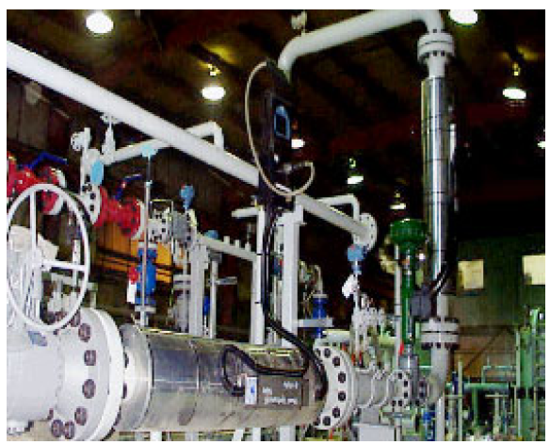
FSM Technology in Application

Slide 89
Why FSM Technology?
FSM is non-destructive and accurate
FSM monitors actual changes in the pipe wall as opposed to e.g. probes
FSM detects corrosion and other metal loss over an extended area such as welds, bends, etc.
FSM can be used in high and low temperature applications without drift in the readings or reduced accuracy
FSM reduces costs due to pipe failures by predicting locations of potential localized defects.

Slide 90
FSM Applications
Oil and Gas Pipelines – FSM is positioned to detect corrosion at the most critical location, typically over a previously pitted area, the well-head or at locations where corrosion may occur
Process oil and dry gas transportation pipelines – it is possible to design with low corrosion allowance and without intelligent pigging facilities – FSM may give you the edge you need
Tanks and storage vessels – FSM measures corrosion
of any electrically conductive structure

Slide 91
FSM features
Non-destructive technique
Measures changes in the actual pipe wall
Relatively large area can be monitored
Provides early warning of effects of process
changes on corrosion conditions
No theoretical temperature limit
Reduced life cycle inspection cost
Provides repeatability
Shutdown is not necessary for installation.

Slide 92
FSM Installations
Depending on pipe geometry and the desired monitoring area. The measuring pins are fixed to the pipeline using a low impact stud welding procedure
Depending on the monitoring requirements, a matrix can be arranged to cover the entire pipe circumference, or just to focus on the most susceptible area of the line.
In any case, the total monitoring area covered by an FSM-matrix is much larger than that of a corrosion probe or coupon.

Slide 93
Hydrogen Flux Monitoring
One of the common corrosion products of iron or steel in a neutral or acidic medium is atomic hydrogen.
Normally, these highly reactive species combine with other hydrogen atoms to produce a relatively harmless molecule, hydrogen gas (H2).
In the presence of some catalysts such as sulfur, arsenic, or tin, the hydrogen atoms dissolve into the steel to a significant degree

Slide 94
Hydrogen Flux Monitoring
This generation of atomic hydrogen can be used for corrosion monitoring purposes in both intrusive or non-intrusive forms.
In the latter, hydrogen monitoring sensors are often attached to the
outside walls of vessels and piping.
It is the diffusion of atomic hydrogen into the metallic substrate that is of most concern, as it can lead to problems such as hydrogen induced cracking.

Slide 95
Hydrogen Flux Monitoring
Hydrogen monitoring probes are based on either of the following Three principles
Pressure increase with time in a controlled chamber, as hydrogen passes through the material into the probe chamber
An electrochemical current resulting from the oxidation of hydrogen under an applied potential
Current flow in an external circuit, based on a fuel cell principle, whereby hydrogen entering the miniature fuel cell causes the current flow.

Slide 96
Hydrogen Flux Monitoring
This "uptake" of hydrogen occurs when the recombination of hydrogen atoms and subsequent release as molecular hydrogen into the
environment is impeded.
Hydrogen monitoring is highly applicable to the oil refining and petrochemical industries with hydrocarbon process streams.
The presence of hydrogen sulfide in these industries promotes the uptake of hydrogen into plant items

Slide 97
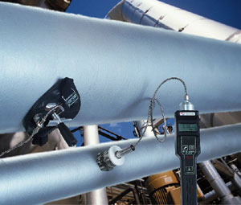
Hydrogen Flux Monitoring
Portable monitoring tool for sour, HF and high temperature corrosion and diffusible hydrogen damage in steel.
The intrinsically safe instrument is totally non-intrusive and with minimal test surface preparation, and no consumables such as grease required, reliable measurements can be made within a minute.
Measurements can be taken from small pipes and large vessels, at any orientation and at any temperature up to 500 °C (932 °F), with a single probe.

Slide 98
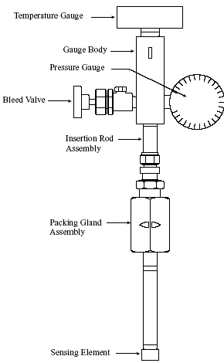
HYDROGEN FLUX MONITORING
INTRUSIVE HYDROGEN FLUX PROBE (FINGER PROBE)

Slide 99
Corrosion Potential (Ecorr) Monitoring
The measurement of the corrosion potential, often called Ecorr, is a relatively simple concept, with the underlying principle widely used in industry for
monitoring reinforcing steel corrosion in concrete and
structures such as
buried pipelines under cathodic protection.
Monitoring of anodic protection systems is a further application area.

Slide 100
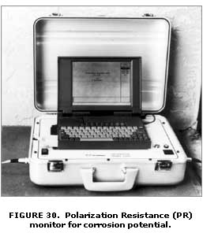
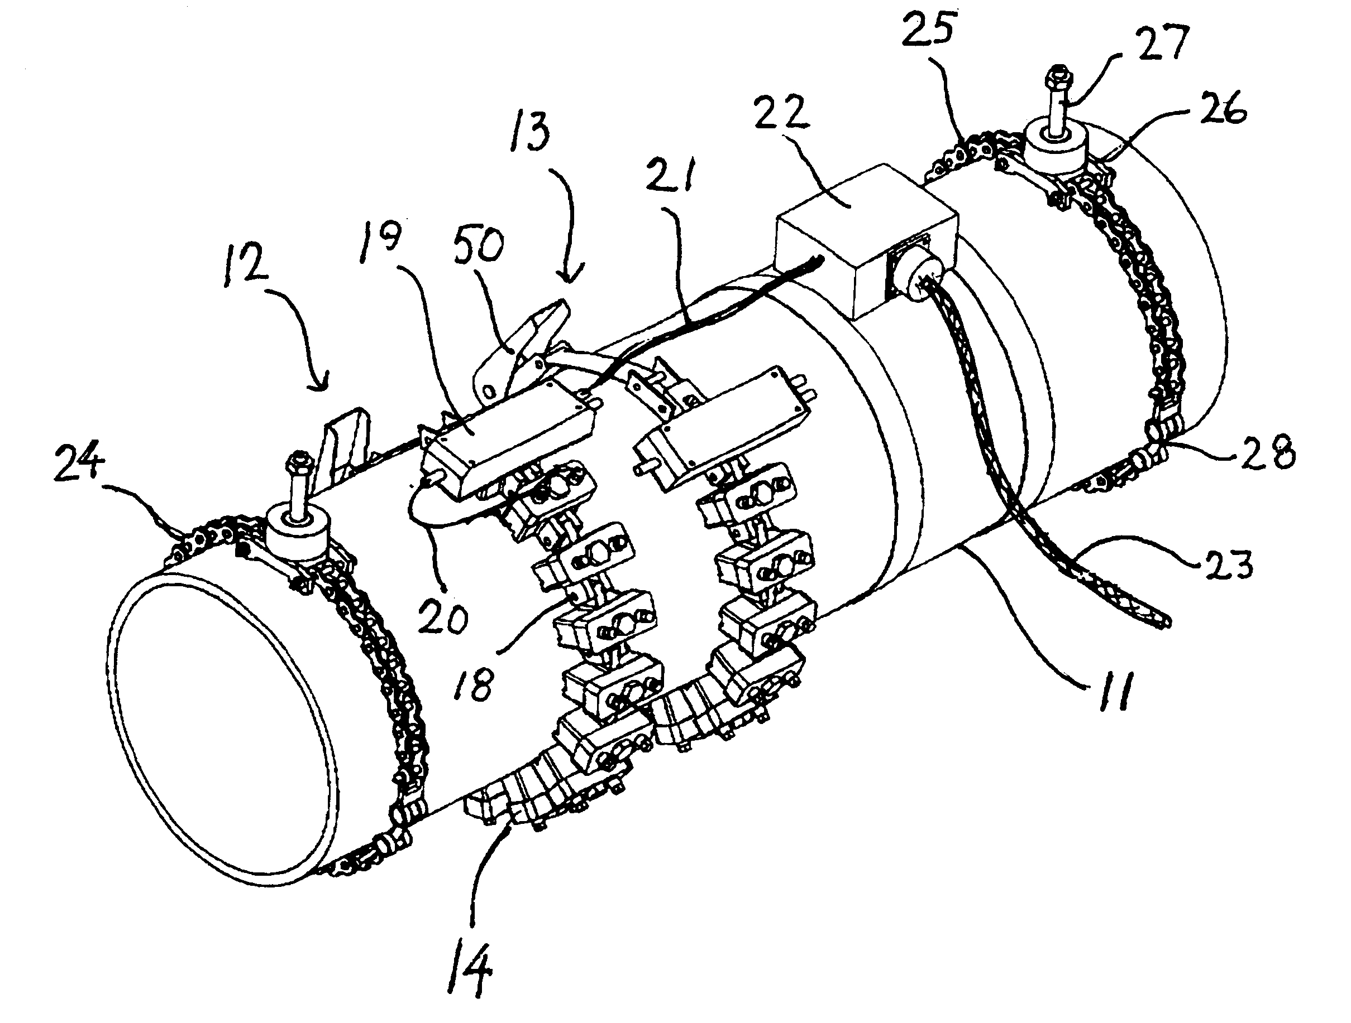
Sensoring Device For Monitoring Potential

Slide 101
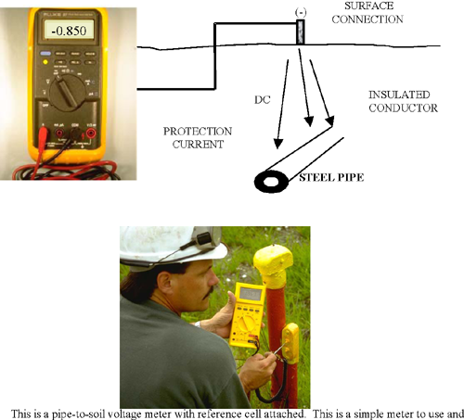
PIPE-TO-SOIL POTENTIAL READING

Slide 102
Corrosion Potential (Ecorr) Monitoring
Changes in corrosion potential can also give an indication of active/passive behavior in stainless steel.
When viewed in the context of Pourbaix diagram, the corrosion potential can additionally give a fundamental indication of the thermodynamic corrosion risk.

Slide 103
Chemical Analyses
Different types of chemical analyses can provide valuable information in corrosion monitoring programs.
The measurement of pH, conductivity, dissolved oxygen, metallic and other ion concentrations, water alkalinity, concentration of suspended solids, inhibitor concentrations and scaling indices all fall within this domain.
Several of these measurements can be made on-line using appropriate sensors.
In many situations, process status and product quality are determined by using chemical methods for which advanced and automated systems for chemical analysis are used.

Slide 104
Planned implementation
Once the priorities have been assessed it is possible to plan the implementation of the monitoring based on:-
Suitable techniques
Existing monitoring points
Available budget

Slide 105
Planned Implementation
This Detailed Engineering phase may require some assistance from Expert Group, Collecting comprehensive data will assist in specifying the correct sensor:
Process composition, temperature and flow rate
Phase of interest (if multi-phase)
Process vessel or pipe material, size and wall thickness
Access type

Slide 106
DATA COLLECTION
One of the most crucial elements in a successful monitoring programme is the selection of appropriate instrumentation. Data collection must be simple and provide plentiful information at an acceptable cost.
Ordinary corrosion monitoring as it is commonly practiced can be termed Baseline Monitoring. It gives enough corrosion rate information to decide if overall target rates are being achieved, but provides few details of why and when corrosion occurs.

Slide 107
DATA COLLECTION
If the data is to be related to other process variables and used to solve problems it needs to be available in greater depth and more quickly
This type of monitoring can be termed PRO-ACTIVE, and the more nearly real-time the data the more active the use which can be made of it
It is highly beneficial if the data becomes available in a digital, computer friendly format that aids analysis and presentation

Slide 108
DATA COLLECTION
Options for collection
Manual methods using hand held instruments
Continuous data logging using field mounted units and collecting data modules periodically
On-line (real-time) instruments cable linked to a central location giving continuous data.

Slide 109
DATA COLLECTION
Manual methods have a lower annual cost per location but provide less data than either continuous data logging or real-time
In order to conduct pro-active monitoring of key locations they are unlikely to yield the depth of data required

Slide 110
DATA COLLECTION
The cost of data collection from a monitoring point can be expressed as an annual sum or as a cost per data item
The more automated methods are dramatically less expensive per item than manual methods.

Slide 111
Data - Information – Solution
It is important that the corrosion data is not viewed in isolation. It is when corrosion data is placed in context with other process data that useful information is most likely to emerge
A complex inter-relationship exists between temperature, pressure, flow rate, treatment and chemical composition, and hence any change in corrosion rate may well relate directly to a change in another, controllable, parameter.
Careful data presentation can reveal the keys to operating a process more efficiently and profitably.

Slide 112
Data - Information – Solution
Corrosion is rarely an absolutely uniform process.
Because we are used to seeing corrosion rates derived from weight loss coupons and presented as annualized rates we can easily be deceived into thinking of
‘corrosion as a steady state process’ !!!

Slide 113
Data - Information – Solution
In fact it is more often episodic in nature: periods of very low corrosion and short periods of very high corrosion
If we can identify the cause of the high corrosion events
we can begin to take control.

Slide 114
ONE WAY TO REDUCE THE NEED FOR MULTIPLE
MONITORING SITES
IS
EMPLOYING MODERN CORROSION MONITORING
TECHNOLOGY
THESE TECHNIQUES CAN BE DIVIDED INTO TWO DISTINCT
GROUPS,
Viz. THOSE PROVIDING INDICATIONS OF THE
CUMULATIVE DAMAGE SUSTAINED (retrospective)
&
THOSE PROVIDING INDICATIONS OF THE PREVAILING
CORROSION RATE (usually online and continuous).

Slide 115
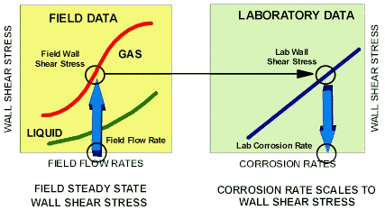
Correlation with Operating Systems
The wall shear stress on the test sample is the correlation factor used to relate the corrosion results to field operating systems. Wall shear stress measures the interaction of a flowing fluid with a solid surface. It can be related to any flow geometry, because it is a basic fluid/wall interaction phenomena and not a function of the specific flow geometry.

Slide 116
Correlation with Operating Systems
Data from any experiment that determines the wall shear stress acting on the test specimen can be effectively used for direct correlation to any flow geometry. Therefore, the wall shear stress calculated for an operating system is identical in its effect on corrosion to the wall shear stress in the experiment.
The corrosion rate measured in the experiment is then directly related to the expected corrosion rate in the operation.

Slide 117
Excellent agreement between coupon corrosion rates and pitting susceptibility and online corrosion monitoring data in liquid and vapour phases in a dehydrated gas pipeline environment containing methane, carbon dioxide, condensing water and glycol

Slide 118
Online, real-time relationship between corrosion rate and feed rate of neutralising chemicals in 98-99% process

Slide 119
Online, real-time relationship between corrosion rate and feed rate of neutralising chemicals in
98-99% process
Operators had varied the concentration of a neutralising chemical in the process. However, contrary to what was expected, it was found that increasing feed rate of neutraliser increased corrosion rates rather than reducing them.
This new information helped reduce corrosion rates and also provided chemical engineers with new insight into the chemistry of process.

Slide 120
Corrosion monitoring has evolved from offline to online and online real time measurements

Slide 121
The data depicts real time corrosion on a hydrocarbon/water stream, show that the rate of corrosion is not steady over time. Peak corrosion episodes occur

Slide 122
The data in Figure shows that the
corrosion rate was mostly minimal
over an approximately two-month period.
However, there were about 20 episodes
of high corrosion rate (corrosion
upsets that were one to two orders of
magnitude above baseline levels) during
this period. Generally, the trend in
corrosion rates increased with water
content, but it is clear that water content
was not the only factor — another
variable was likely in play.
In oil/water systems, periodically stratified flow conditions can develop at low flow rates where the water separates from the oil. This can lead to an increase in corrosion activity, particularly at the six o’clock position in piping. In this case, the real time corrosion measurement was more reflective of corrosion upsets than the infrequent process monitoring being performed.

Slide 123
Real-time corrosion data in a dehydrated hydrocarbon-gas stream shows six episodes of corrosion over two months
A shorter interval to reveal the detail of a single upset that is likely related to upsets in dehydration

Slide 124
The graphical presentation shows electrochemical monitoring data from a
dehydrated hydrocarbon gas stream.
During a two month period, six episodes of higher corrosion rate were observed,
whereas the magnitude of the corrosion excursions was not as great as in the
oil/brine system.
The excursions do constitute periodic and significant increases in corrosivity, particularly, since corrosion allowances are typically much smaller in these “dry” systems.

Slide 125
These cases highlight situations that could be remedied by better process control (separation, dehydration and/or flow control), or more effective dosing of inhibitors
at intervals
defined by the real time corrosion measurement, rather than based on historical, average corrosion rates.
A related condition in many gas streams is the need to maintain inlet gas quality to reduce out-of-specification conditions from
moisture, CO2 or H2S.

Slide 126
Zero Resistance Ammetry
In the ZRA technique, a macrocell current is measured between two corrosion sensor elements. It is obviously a useful technique to measure the magnitude of galvanic current flow between different materials or different microstructures of the same material.
Preferential weld corrosion has been measured with ZRA.
Perhaps somewhat surprisingly, the measurement of macro-cell current has also been applied to identical sensor elements, as a basic indicator of corrosion severity.
Such measurements are mainly relevant to detecting the early stages of the breakdown of passivity and the early stages of corrosive attack. For reinforcing steel (rebar) in concrete, this principle has been adopted in the ASTM G102 test procedure and also \in a rebar corrosion monitoring system.

Slide 127
Zero Resistance Ammetry
Consider two identical probe elements. When both elements are passive, the macro-cell current will be negligible. A macro-cell current will tend to develop when surface passivation breaks down on one of the sensor elements. Even if passivity is lost on both sensor elements, a macro-cell current may still be registered when the degree of corrosive attack is not be the same on both elements.

Slide 128
Anodic Zone
Cathodic Zone

Slide 129
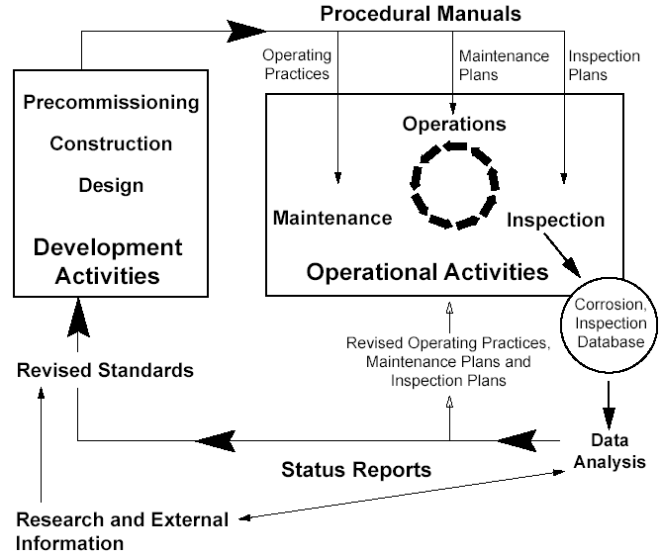
INFORMATION FLOW IN CORROSION MANAGEMENT

Slide 130
THE ORGANIZATION AND MANAGEMENT OF THE
MONITORING SCHEME SHOULD ALSO BE DEFINED
AND CLEARLY IDENTIFIED WITH RESPONSIBLE
INDIVIDUALS OR GROUPS
AN INFORMATION FEED BACK LOOP IS REQUIRED
TO ENSURE THAT APPROPRIATE AND TIMELY
ACTION IS TAKEN.
THE SUCCESS OR FAILURE OF ANY CORROSION
MONITORING PROGRAMME IS DEPENDENT NOT ONLY
ON THE TECHNOLOGY BUT ALSO ON
SUITABLY
MOTIVATED PERSONNEL OPERATING
WITHIN AN
APPROPRIATE ORGANIZATIONAL STRUCTURE

Slide 131
CORROSION MANAGEMENT INFORMATION FLOWS
Feed Forward
(Corrosion Management Manuals)
Operating
Conditions/
Practices
Maintenance
Plans
Inspection
Plans
Pre-Commissioning
Facilities Construction
Facilities Design
Maintenance
Equipment Fabrication
Operations
Inspection
Equipment Design
OPERATIONS PHASE
Corrosion
Inspection
Data Base
DEVELOPMENT PHASE
Revised
Operating
Conditions/
Practices
Revised
Maintenance
Plans
Revised
Inspection
Plans
(Revised) standards
Data Analysis
(Status reports)
Feed Back
Input from research
And other sources

Slide 132
Design
Failure
Investigations
Nominated people
Perform,or lead,
investigations
Fabrication
Registration of
Failure incidents
Installation
Plant reliability
performance
Operation
Failures,
Downtime,
Production loss,
etc
Maintenance
Route causes
Proposed
Solutions and
Failure
categories
Inspection
Database
Actions in response
To collective reliability
trends
Agreed
Categorisation
And follow-up
actions
Target
reliability
Collective
failures
Reliability policy
Compare
Problem register meetings
Action approval
Individual failures
Actions in response to
individual failures
Management controls
Overall model for closed-loop control of plant reliability

Slide 133
Nothing is Forever
Because the causes of corrosion are often complex - it is dangerous to assume today's solution will hold forever.
This is especially true of oil & gas production where reservoir conditions change continuously throughout the life of the field.

Slide 134
Nothing is Forever
When you have established an understanding and taken control it is not time to relax.
Solutions must be validated by continued testing and changes must be anticipated. Keep the monitoring programme in place, properly maintained and fully functional
Be prepared to experiment a little !!!
If corrosion rates are stable at one location, why not move the equipment somewhere else for a while?

Slide 135
Nothing is Forever
Remember that to maintain continuous improvement requires us to keep asking questions about the system

